Slide 1


SHANMUGANATHAN ENGINEERING COLLEGE (Accredited by NAAC, an ISO 9001:2015 Certified Institution) ARASAMPATTI – 622 507 DEPARTMENT OF ELECTRONICS AND COMMUNICATION ENGINEERING
DASHBOARD INTERFACE WITH REACT
PRESENTED BY
K.ELLAIKARUPPAN (912421106301)
B.VIJAY (912421106022)

Slide 2
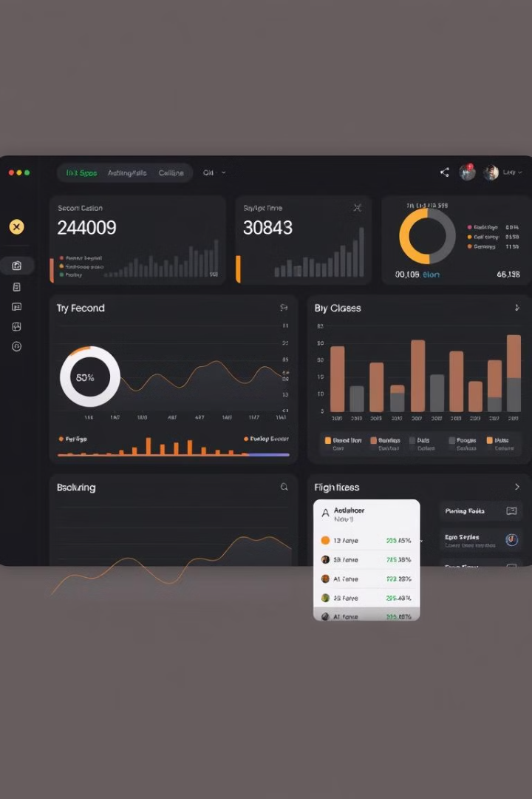
Dashboard Interface with React
Dashboards are powerful tools for presenting complex data in a clear and organized manner. By leveraging the flexibility and component-based architecture of React, developers can create dynamic, interactive, and visually stunning dashboard interfaces.

Slide 3

What is a Dashboard?
Data Aggregation
Actionable Insights
A dashboard consolidates key metrics, KPIs, and data insights into a single, easily digestible view.
Dashboards empower users to make informed decisions by presenting data in a clear and visually compelling way.
Customization
Real-time Monitoring
Dashboards can be tailored to the specific needs and preferences of individual users or teams.
Dashboards can provide up-to-the-minute data, allowing for timely responses to changes in performance or trends.

Slide 4
Benefits of Using React for Dashboards
Reusable Components
Efficient Rendering
Customization and Flexibility
React's component-based architecture allows for the creation of modular, reusable UI elements that can be easily integrated into a dashboard.
React's virtual DOM and efficient diffing algorithm ensure fast and smooth updates, even with complex data visualizations.
React's extensibility and rich ecosystem of libraries and tools provide limitless possibilities for customizing and enhancing dashboard functionality.

Slide 5
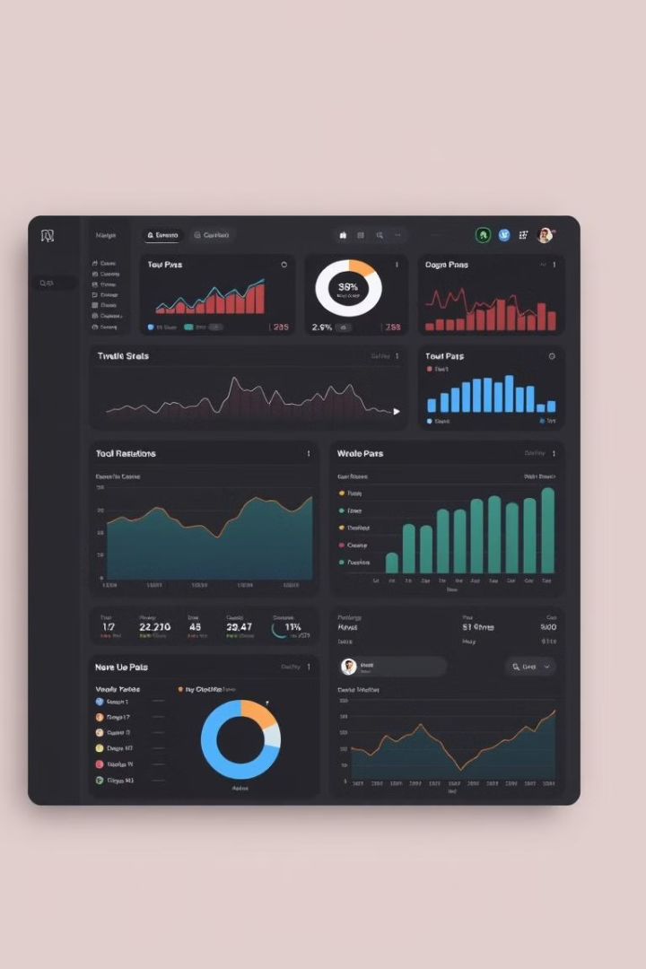
Key Components of a Dashboard
1
Data Visualization
2
Metrics and KPIs
Charts, graphs, and other visual representations of data that help users quickly identify trends and insights.
Key performance indicators and important metrics that provide a high-level overview of business or operational performance.
3
Filtering and Sorting
4
Drill-down Capabilities
Mechanisms that allow users to customize the data displayed, such as date ranges, categories, or other criteria.
The ability to explore data in greater detail by navigating to more specific views or reports.

Slide 6
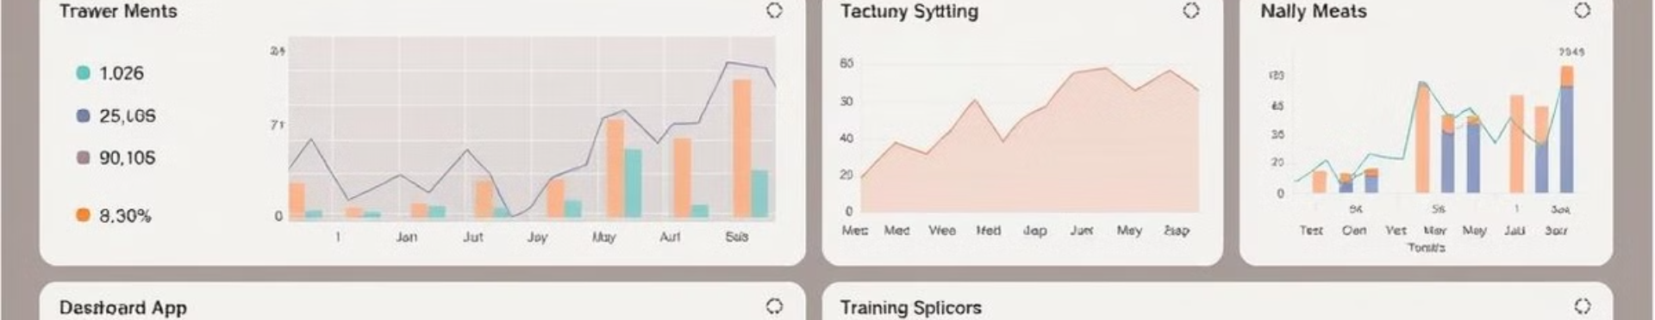




Data Visualization Techniques
Bar Charts
Line Graphs
Pie Charts
Scatter Plots
Effective for displaying and comparing quantitative data across different categories.
Useful for visualizing trends and patterns over time.
Ideal for displaying the proportional composition of a whole.
Reveal relationships and correlations between two variables.

Slide 7




Interactivity and User Experience
Hover and Click
Tooltips and click-through functionality provide users with additional data and context.
Filtering and Sorting
Interactive controls allow users to customize the data displayed on the dashboard.
Drill-down and Exploration
Users can navigate to more detailed views or reports by clicking on specific data points.

Slide 8
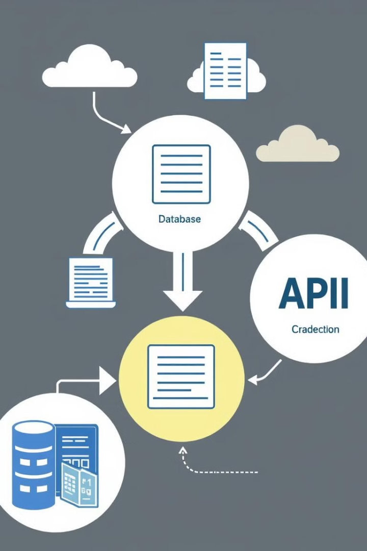
Fetching and Managing Data
1
Data Sources
Gather data from various sources, such as databases, APIs, and real-time data streams.
2
Data Transformation
Clean, normalize, and prepare the data for visualization and analysis.
3
Data Storage and Retrieval
Efficiently store and retrieve data to power the dashboard's data visualizations and interactivity.

Slide 9
State Management in React
Component State
Global State
Data Flows
Manage the state of individual components, such as form inputs or UI interactions.
Use state management libraries like Redux or Context API to manage data that needs to be shared across the application.
Ensure efficient data flow between components and state management solutions to optimize performance and user experience.

Slide 10
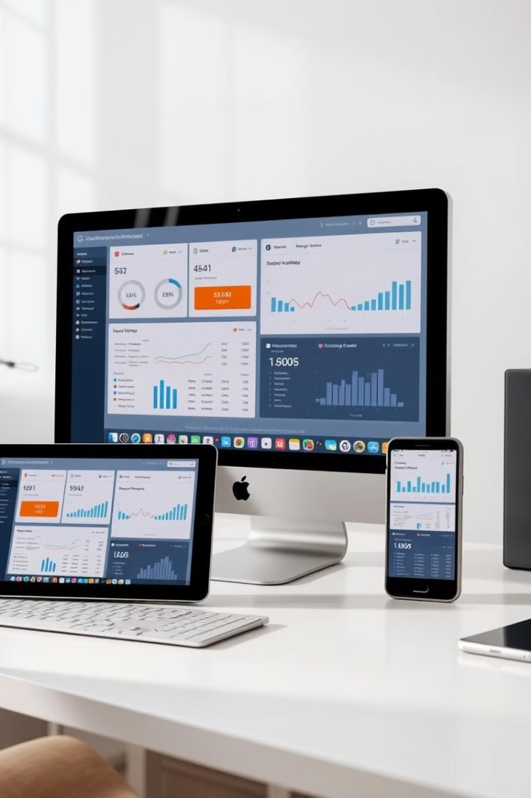
Responsive Design Considerations
Adaptive Layout
Optimized Visualizations
Ensure the dashboard layout and components adjust seamlessly across various screen sizes and devices.
Data visualizations should be legible and intuitive on both large and small screens.
Gesture-based Interactions
Performance Optimization
Enable touch-friendly interactions, such as swiping and pinch-to-zoom, for mobile users.
Minimize load times and ensure smooth performance across all devices and network conditions.

Slide 11

Deployment and Hosting Options
Static Site Hosting
Deploy the dashboard as a static website using platforms like GitHub Pages or Netlify.
Server-side Rendering
Use server-side rendering with frameworks like Next.js to optimize for search engines and initial page load.
Cloud Hosting
Leverage cloud platforms like AWS, Azure, or Google Cloud to host the dashboard and its supporting infrastructure.
Containerization
Package the dashboard application and its dependencies into a Docker container for easy deployment and scaling.

Slide 12
THANK YOU

